Slide 1
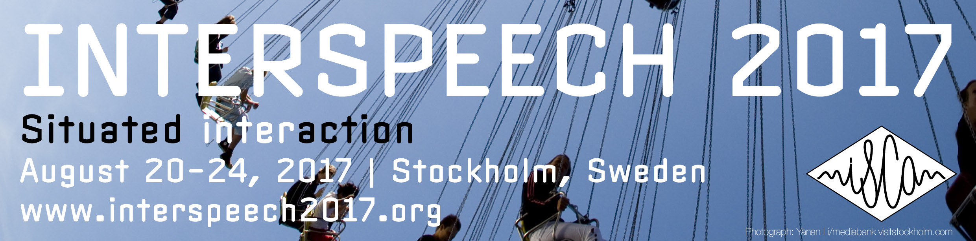
What do Babies Hear? Analyses of Child- and Adult-Directed Speech
Marisa Casillas, MPI-Nijmegen
Andrei Amatuni, Duke University Amanda Seidl, Purdue U. Melanie Soderstrom, U. Manitoba Anne Warlaumont, UCLA
Elika Bergelson, Duke University
Notes:
Hi, I’m going to be telling you today about some recent work we’ve done looking at what children hear in their day-to-day life. We look at this bc understanding how children learn language requires understanding the input they learn it from.

Slide 2
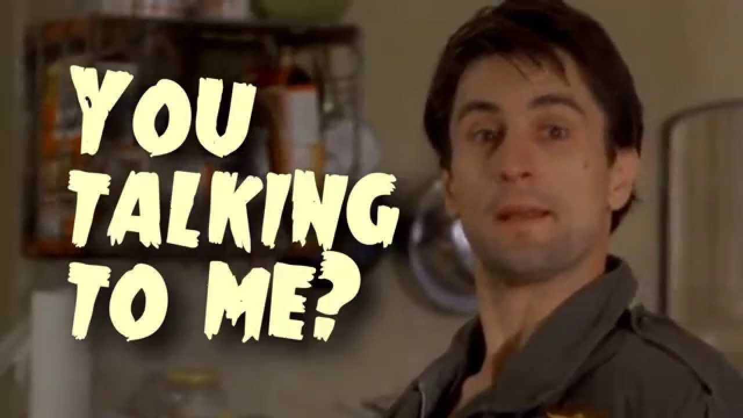
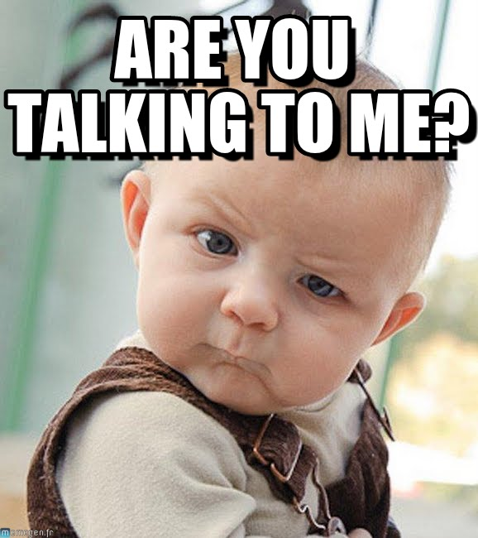
Child-Directed Speech

Slide 3
Background: Child-Directed Speech (CDS), Adult Directed Speech (ADS), & Language Input
CDS preference from birth on (Cooper & Aslin, 1990)
More CDS (but not ADS) = Bigger Vocab at age 2-3 years
in both high and low CDS-producing communities/cultures (Weisleder & Fernald, 2013; Schneidman & Goldin-Meadow, 2012)
Phonetic learning benefits of CDS less clear (cf. Martin et al, 2015)
More generally: lower socioeconomic status (SES) infants hear less language, and have poorer language outcomes (Hart and Risley, 1995; Hoff, 2001)

Slide 4
What’s missing...
Comparing across studies is hard
Sample size, length, outcome measure, age vary
By and large, not ‘representative’ input samples
Hard to conclude much about CDS and ADS across infancy, across SES, across male and female speakers...
Machine classification under-developed
In naturalistic (i.e. noisy conditions)
For CDS/ADS

Slide 5
Central Questions
Sampling from ecologically-valid daylong recordings, how are CDS and ADS in the input influenced by:
Child Age (0-2 years)
Speaker gender
Socioeconomic status (Maternal Education)
How good are human and machine classification of
adult gender
addressee (CDS/ADS)

Slide 6
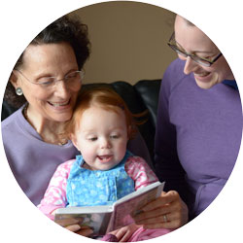
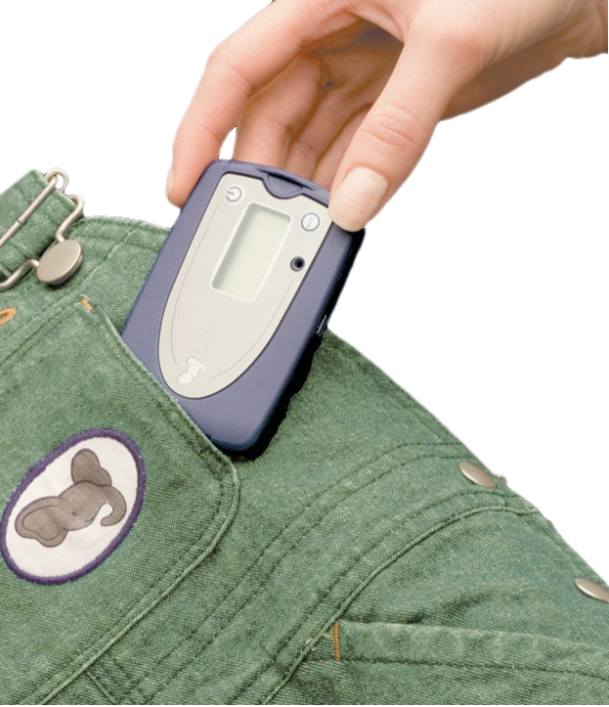
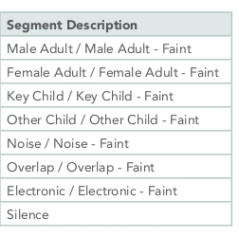
LENA System:
Single microphone
16 hour recording time
automated output:
Speech Detection/Speaker Diarization
Conversational Turn-taking metrics
Word Counts
...
The only ‘end-to-end’ recorder+automated output currently available (help!)
Lena Black-Box Algorithm
Diarization
(GMMs)
Notes:
Minimum Duration Gaussian Mixture Models; periods of speech without too much silence between speaker turns

Slide 7
The Dataset
Daylong (~16 hr) LENA recordings from 61 homes; 4 cities in US & Canada
Sampled uniformly across 0-24 months (Bergelson, VanDam2, Soderstrom, Warlaumont Corpora from HomeBank)
Extracted ~42 hours of audio,
20 (LENA-algorithm defined) ‘conversations’ from each recording
that had at least 10 ‘utterances,’ and at least 1 adult utterance

Slide 8
Machine segmentation, human tagging
12,616 LENA-tagged Male or Female Adult ‘utterances’
Each tagged by 3 human coders:
Speaker gender (male/female/junk)
Addressee (Child-directed/adult-directed/junk)
Removed Junk (13%) & No-Majority tags (.5%)
Final dataset: 10,886 ‘utterance’ segments
used in ComPare Addressee challenge too

Slide 9
Inherent Imbalance
Most input infants heard was:
By Female adults : ~3/4
Child-Directed Speech (CDS): ~2/3
for both male and female speakers
This is not surprising.
Notes:
This imbalance can be statisticall annoying but is important to keep in mind when building theories of language learning

Slide 10
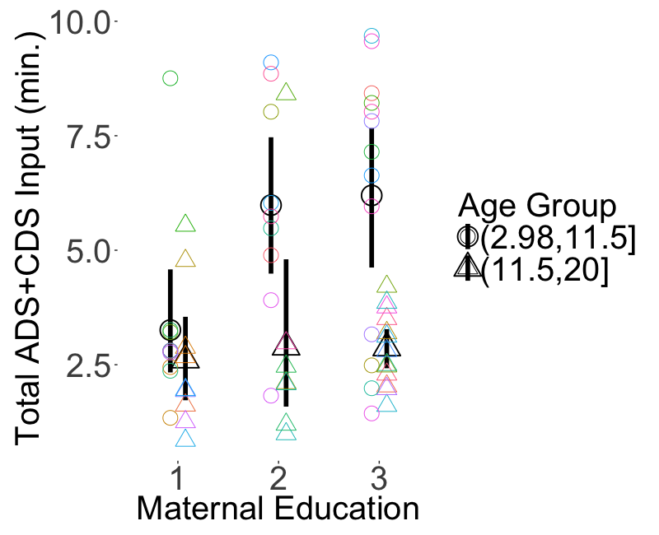
Amount of Language Input, Age and SES
Total Input (ADS+CDS)
Minutes
<12 Months
>12 Months
No B.A. B.A. Adv.Degree
Younger infants hear more language from adults in higher SES homes
Older infants hear equivalent language from adults across SES levels

Slide 11
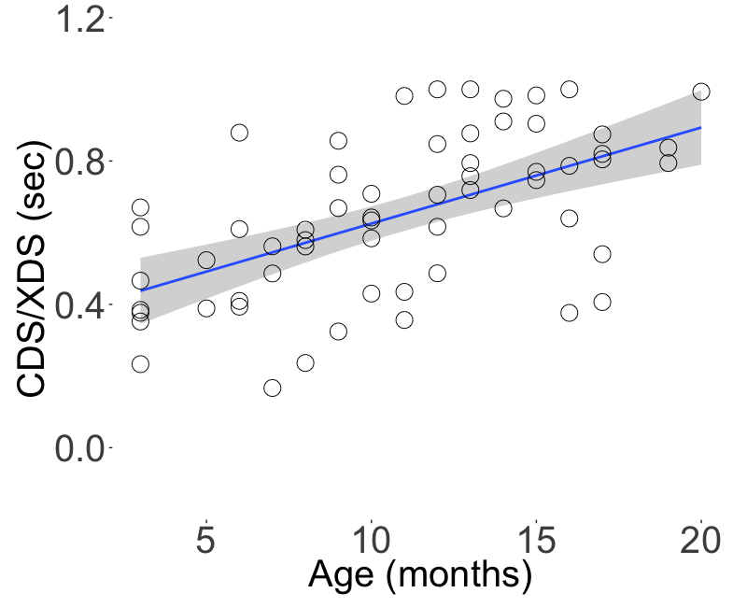
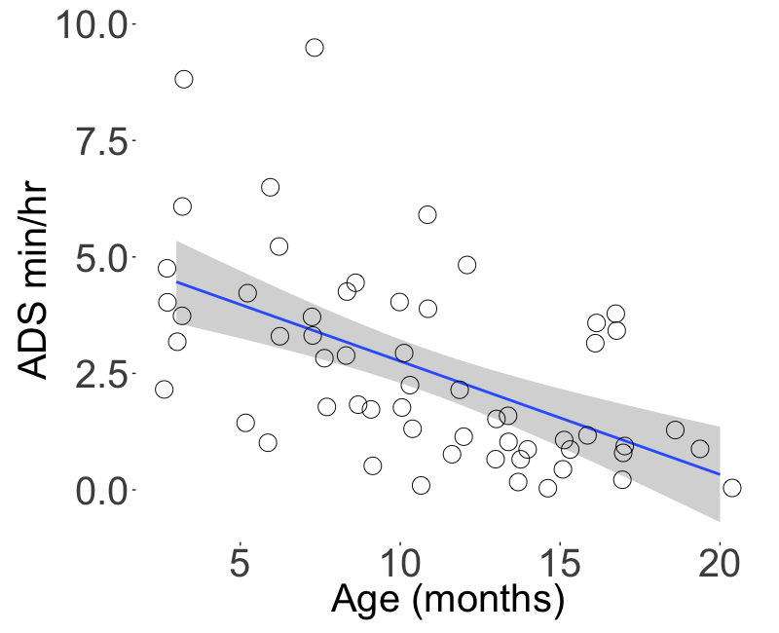
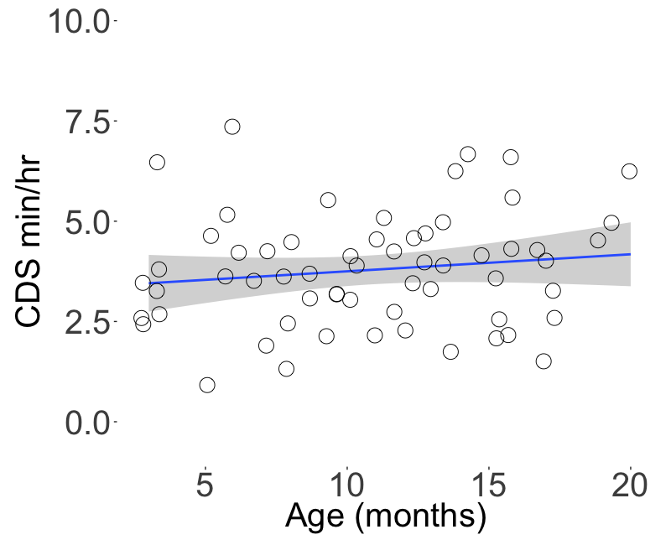
Proportion of CDS by Age
Prop.
CDS/CDS+ADS
Infant Word Production starts around here
Prop. CDS increases significantly
with age
Notes:
The reason it’s useful to calculate the proportion, is it lets you compare to other studies, make claims about how much time you need to sample, etc.

Slide 12
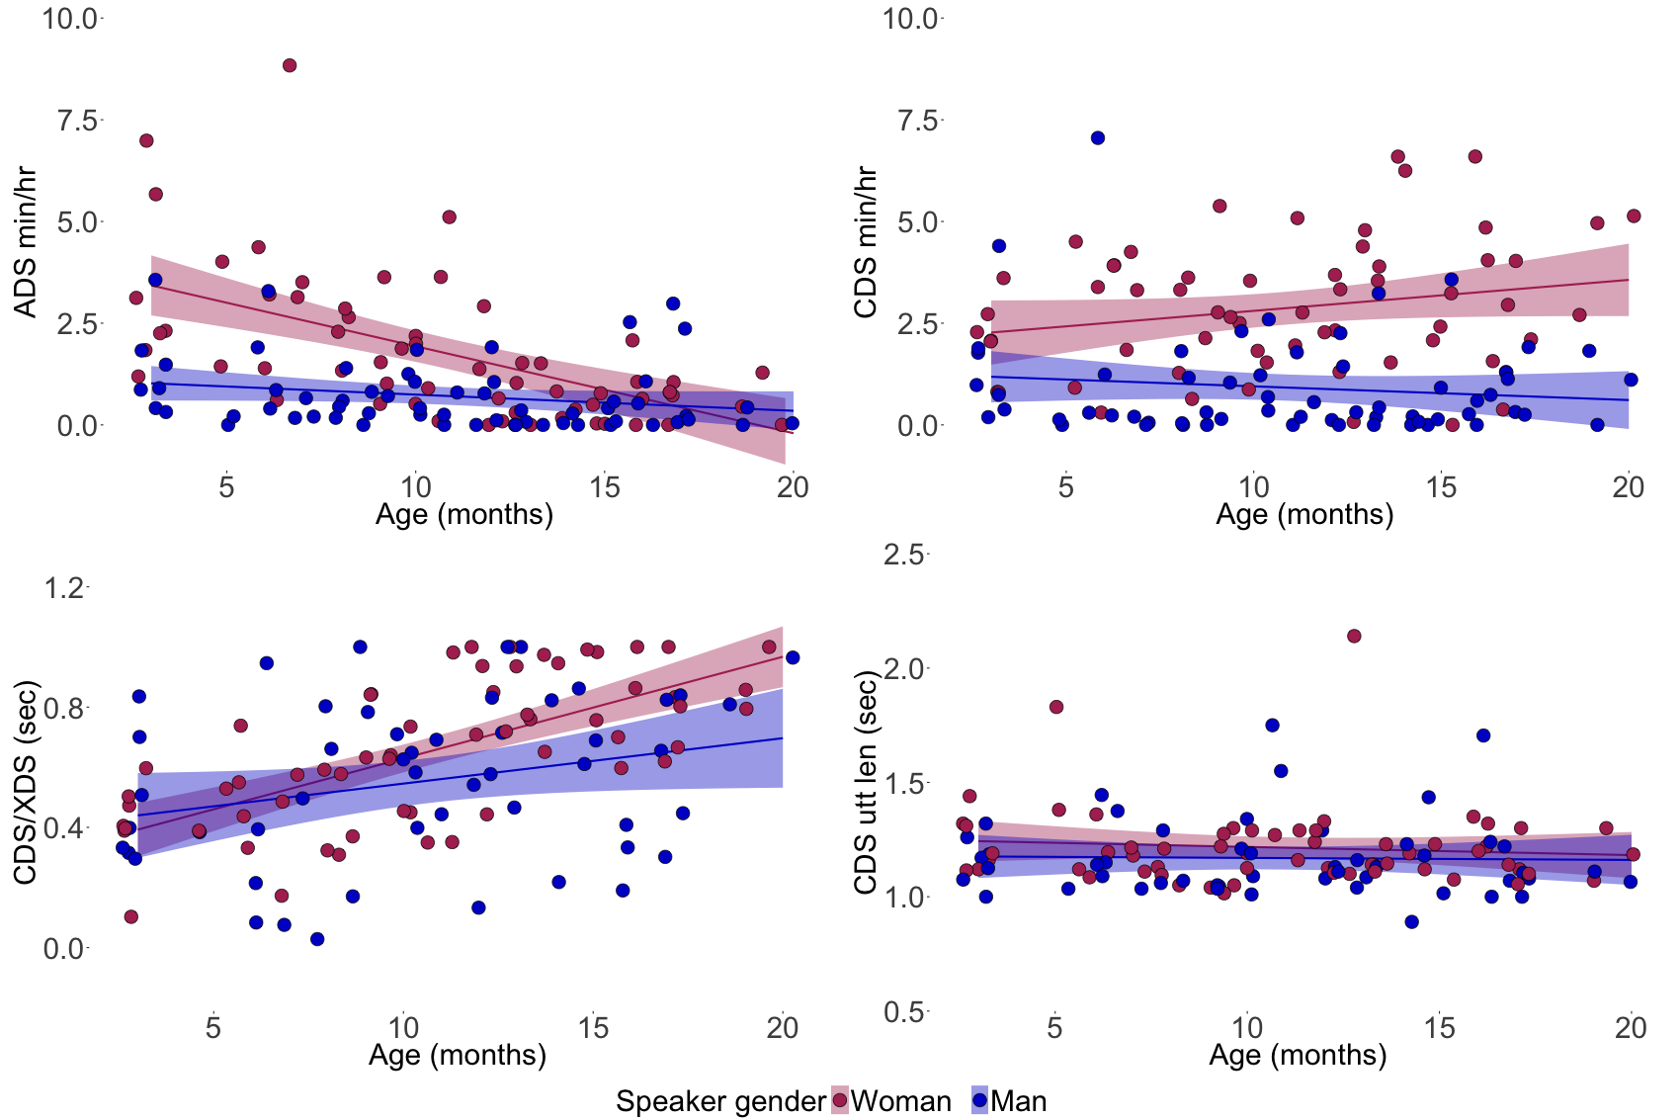
Proportion of CDS by age, Speaker Gender
Prop.
CDS/CDS+ADS
Female Adult
Male Adult
Men produce less speech to children (~25%)
Men’s proportion of CDS rises less with child age (p<.05 by LMER model comparison)

Slide 13
Central Questions
Sampling from ecologically-valid daylong recordings, how are CDS and ADS in the input influenced by:
Child Age (0-2 years)
Proportion of CDS increases with age
Speaker gender:
Adult Females talk more to babies than Males
Relative CDS increase with age stronger for Female Adults
Socioeconomic status
Younger babies in low-SES families hear less talk than babies in higher SES families

Slide 14
Central Questions
How good are human and machine classification of
adult gender
addressee (CDS/ADS)

Slide 15
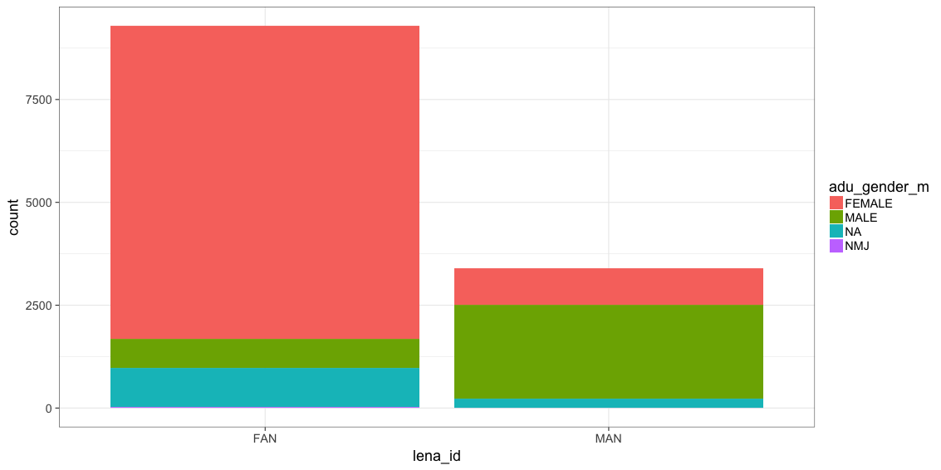
LENA vs. Human Majority Gender Tags
78% Human-Tag Female
Human Majority Tag
No majority
26% Human-Tag Female
7% Human-Tag Male
64% Human-Tag Male
~12% Lena-M/F= Human-tag JUNK
LENA-Female Tag
LENA-Male Tag
LENA is mostly right about gender
This is slightly unfair to LENA: we only assessed false positives not misses
Cases where humans would have tagged ‘male/female’, but Lena tagged ‘overlap’ ‘child’ ‘electronic’, etc. unknown

Slide 16
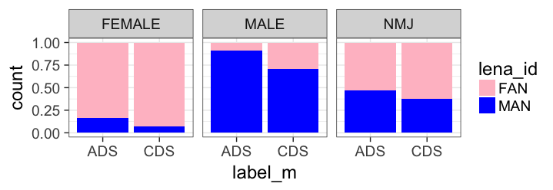
LENA vs. Human Majority Gender Tags vis-à-vis CDS/ADS
Addressee Tags: Inter-rater reliability across 9 human coders for CDS and ADS was high:
Fleiss’s kappa ~.8
Human Majority Female
Human Majority Male
9%
29%
LENA-Female Tag
LENA-Male Tag
16%
7%
Human-Tag Addressee
LENA gender-tag mistakes more likely with female ADS & male CDS
Caveat emptor!

Slide 17
Central Questions
2. How good are human and machine classification of:
adult gender:
Humans: essentially perfect agreement
Machines: mostly right, but systematic in false positives
addressee (CDS/ADS)
Adults: good (well, so are babies!)
Machines: cf. ComParE challenge

Slide 18
Conclusions and Final Thoughts
Increasing proportion of CDS from 0-2 years
Older (talking) babies treated differently by adults
More talk in high-SES homes at young ages
Infants’ talking onset may be ‘equalizing’ force
More talk from women than men
Implications for infants’ phonetic and talker-specific representations
Great naturalistic datasets for looking at demographic and linguistic variables systematically
Could say a lot more if we had better classification tools...but for now, ‘human-in-the loop’ tagging is a promising approach for characterizing early language input

Slide 19
Thanks!
Shameless plug: tomorrow’s ComPare session 10am, E10
Funders: NWO Veni Innovational Research Scheme 275-89-033 (MC), NIH DP5-OD019812 (EB), SSHRC Insight Grant 435-2015-0628 (MS), and NSF SBE-1539129 and NSF BCS-1529127 (AW), Digging Into Data (EB, MS, BS).
RAs who provided gold-standard labels
Kelsey Dyck for assistance developing the labeling protocol
Mark VanDam for sharing his corpus
Brian MacWhinney hosting the HomeBank corpora
families who provided the raw data.

Slide 20
Backup Slides

Slide 21
Ads and CDS by Gender

Slide 22
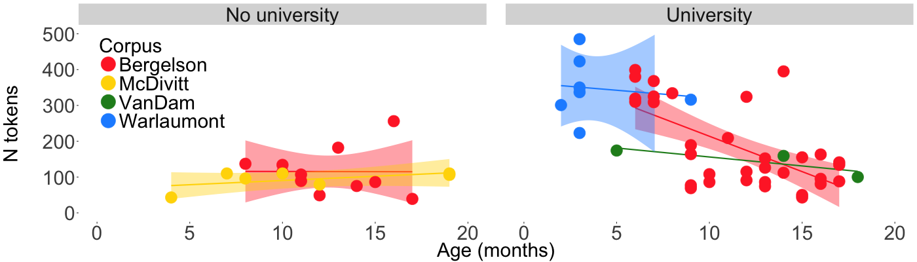
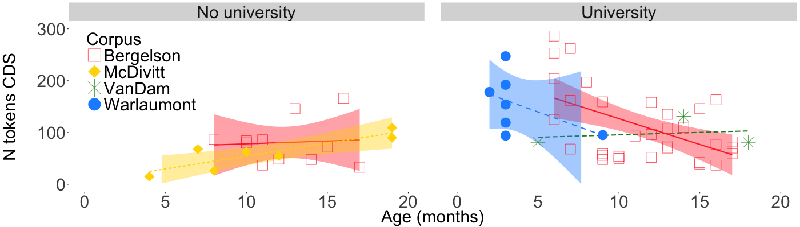
Socio-Economic Status by CDS
Low SES kids hear less talk (overall and CDS only) than High SES kids
SES x age interaction: high SES parents talk especially more to young babies

Slide 23
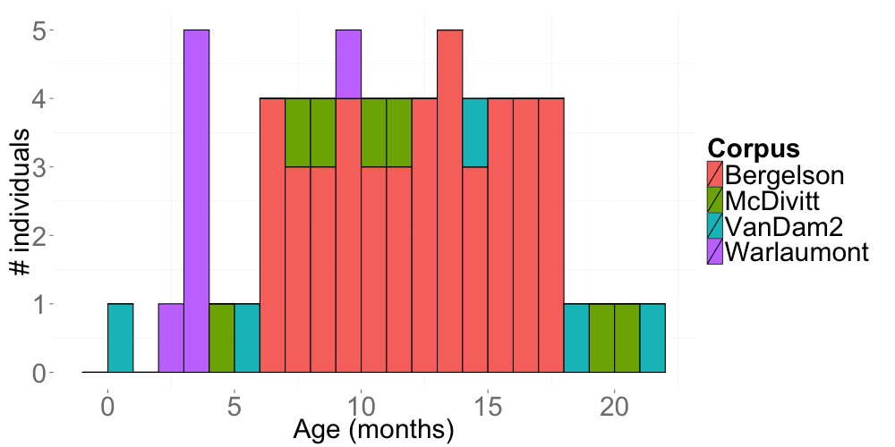

Slide 24
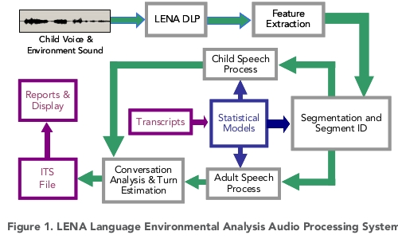
Data collected by LENA recorder
http://www.lenafoundation.org/Research/TechnicalReports.aspx
Notes:
“any human vocalization and end when there is at least 5 seconds of silence or nonspeech sounds. These blocks are labeled by 2 criteria: the speaker that initiated the language block and responders within the block. Any block consisting of only infant or only adult speech unreciprocated within 5 seconds is labeled as a monologue, and any block that contains both infant and adult speech is considered conversational” johnson et al 2014

Slide 25
